Slide 1
Agritourism safety
Managing the Safety Risk
Marion Barnes
Senior County Extension Agent – Distinguished
Clemson University

Slide 2
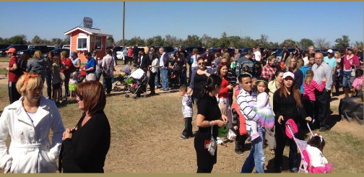
Disclaimer
This information is shared for educational purposes only. All business owners should be advised to regularly seek the advice of an attorney and/ or insurance professional to discuss farm safety and risk management strategies.

Slide 3
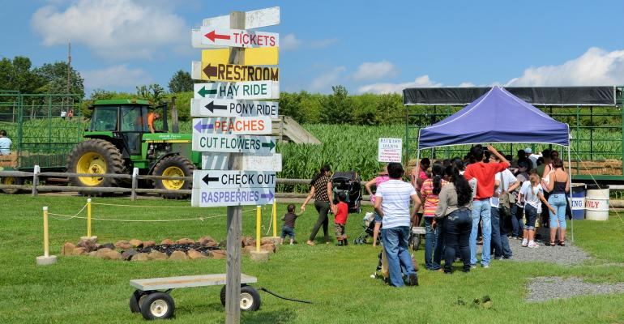
Working Farm Issues
Agriculture ranked in the top 3 most dangerous occupations in US for the past 40 years by NSC.
Almost 70 million people visit farms each year
40% are children
According to CDC 3700 children injured each year visiting farms
Photo credit: American Agriculturist

Slide 4
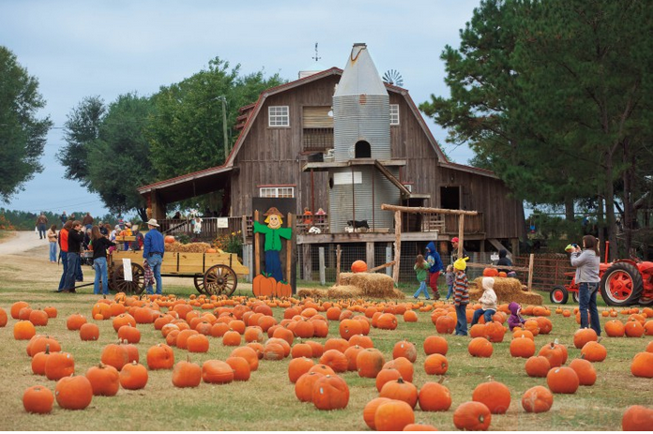
Agritourism Safety Risk
During farm visits guest face certain risk and the farm operator will face greater legal liability
We must understand the risk in order to better manage them
Photo credit: Farm Flavor

Slide 5
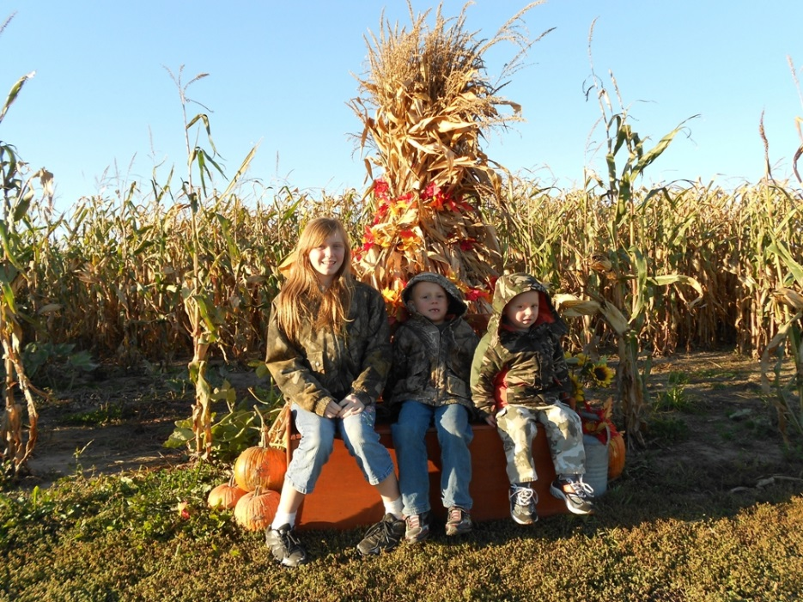
Managing the Safety Risk
View Agritourism safety as a program, incorporating steps to prevent/ limit visitors exposure to risk and have a plan to respond to adverse incidents if they occur
Protecting your visitors from injury will protect you & your assets.

Slide 6
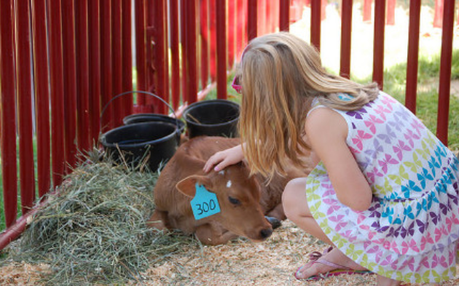
Visitors on the farm create challenges
Visitors may not always understand the safety hazards that exist on the farm
May not follow instructions
May be involved in an incident
May falsely claim they were injured on your farm
Photo credit: City of Greeley via Flicker/ Morning AgClips

Slide 7
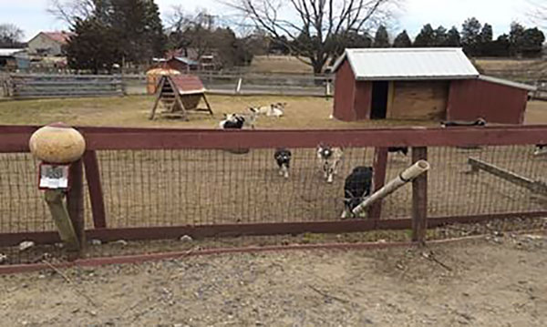
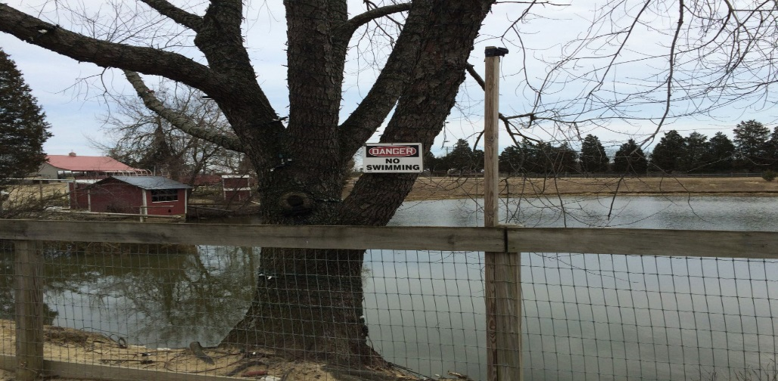
Agritourism Safety Risks
Each farm has its own unique safety risks
Risks can be managed, & reduced but never fully eliminated
Know your legal & liability obligations
The safety of your farm visitors are
non-negotiable!

Slide 8
Steps for reducing safety risks
Identify & manage potential safety hazards
- conduct a comprehensive assessment of potential risk on
the farm
- identify these risks & the steps to minimize them in a
farm safety plan
Educate & train employees, educate & train employees!!
- Maintain a record of employee training
Communicate safety risk & expectations to visitors
Estb. an emergency response plan & procedures
If it can be predicted it can be prevented, if it can be prevented, it is not an accident!

Slide 9
Develop a Farm Safety Plan
Regularly inspect your farm by conducting a walk- through of all areas accessible to visitor (including those that are off limits to guests)
- keep a record of inspections
I.D. hazards that could jeopardize the safety of visitors & employees
- view your farm through the “eyes” of someone unfamiliar w/
farming and its risks,- “What hazards might children
encounter?”
- have a “professional”, emergency responder, Ins. agent, etc.
to walk through the farm w/ you(another persons perspective)
Develop a farm safety plan to limit visitors exposure

Slide 10
Purpose of A Farm Safety Plan
Outline of safety rules/ procedures (in writing) for a safe environment for employees, family members & farm visitors
- establishes safety procedures for specific activities
(e.g., parking, hayrides, petting zoos, food service, etc.)
- designates areas off-limits to the public.
- is a basis for training employees how to properly manage farm
activities, I.D. safety issues & monitor activity on the farm.
Facilitates emergency response by providing:
- contact information for farm owners(s) & employees
- a farm map detailing important locations
- emergency contacts for farm owners & employee (EMS, Fire/Rescue)

Slide 11
Farm Safety Plan- Plan of Operation
Develop a written plan of operation for each agritourism activity that:
- describes the activity
- identifies potential risk
- outlines strategies for minimizing risks to guests
- identifies the location(s) for posting warnings or rules
Plans of operation provide proof of efforts to protect the safety of farm visitors
- an important component of reducing farm liability in case of
an accident

Slide 12
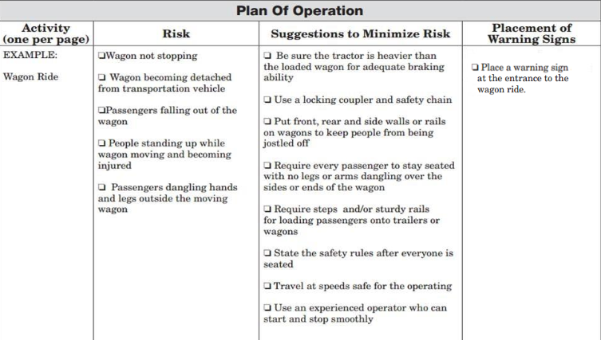
Plan of Operation – Wagon Ride

Slide 13
Plan of Operation- Petting Zoo
I.D. potential risk:
- disease transmission
(salmonella, E.coli, Crypto)
- injuries from animal biting,
kicking, or butting
Strategies to minimize
risks:
- double fence
- feeding chute
- post warning signs such as:
“ THESE ANIMALS HAVE
TEETH, THEY BITE”

Slide 14
Examples of Potential Risks
Parking & traffic
Walkways & trails
Buildings & restrooms
Kids on the farm
Animals
Fencing & barriers
Venomous snakes & insects (bees, wasps, fireants)
Hay or wagon rides
Corn mazes
Play areas
Food service (food safety)
Disability accommodations
Hazardous weather
Fire prevention
Farm equipment
Ponds & attractive nuisances
Pesticides / chemicals
Other risks

Slide 15
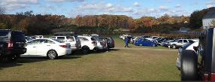


Traffic & Parking Safety Considerations
Driveway/ entrance marked & visible from road
Separate entrance & exits
Parking on public roads prohibited ?
Adequate parking
- separate areas for auto’s &
and buses (pickup & dropoff)
Internal farm traffic lanes wide enough

Slide 16
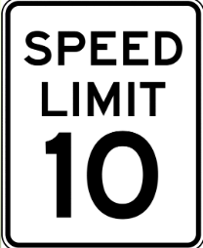
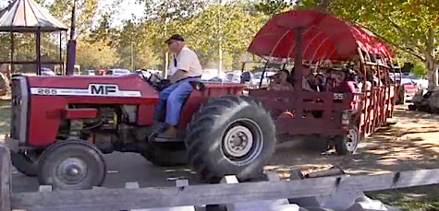
Traffic & Parking Safety Considerations
Speed limits posted
Are parking areas firm, drained, level, w/out obstructions, & mowed
Adequate lighting ?
Easily identified & safe for visitors
Adequate parking/ traffic control (workers)
Plans in the event of rain, mud, etc.

Slide 17
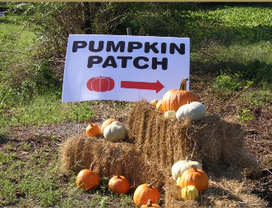
Walkways & Trails Safety Considerations
Paths should be smooth, level & free of steep grades
Trails & walkways clearly marked
Slick surfaces free of sand, oil, etc.
Remove hoses, wires, limbs, & other debris

Slide 18
Buildings & Restrooms
Make sure all buildings meet codes & in compliance
- falls are a major cause of farm accidents
- pay particular attention to stairs, steps, walkways
- utilize handrails or grab bars where there are steps or changes
in elevation (Example: hay or wagon ride trailers)
- proper housekeeping & lighting of walking surfaces can prevent
many slips, trips & falls
Provide clean, well stocked restrooms or regularly maintained portable toilets
Keep portable toilets in cool dry area
Provide multiple handwashing stations
Adequate lighting for after dark activities

Slide 19
Safety Considerations for Kids
Children are naturally curious & see a farm as a big play ground.
Children are unpredictable & may or may not follow safety instructions
The child's safety is up to the supervising adults who may not fully understand the safety risk of agricultural operations.
Its important to talk to children & adults about safety when visiting a farm.
Explain hazards around the farm. Post rules

Slide 20
Safety Considerations for Kids
Inform guest & children about any rules & hazards at specific attractions like hay rides & corn mazes. Explain how these rules will keep the safe.
Placed signs in & around where hazards are present w/ short safety messages.
Provide detailed health & safety infor. in advance of
prearranged visits.
Examples of infor:
- list of hazards
- required child-to-chaperone ratio
- proper attire (shoes, long pants, etc.)
- reminders about what not to bring (such as pets)

Slide 21
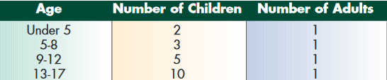
Safety Considerations for Kids on Farms
Secure or remove “attractive nuisances”
- object or condition(s) that
attracts someone, especially
kids to investigate or play
Example- hay storage areas,
ponds, ATV’s, equip., etc.
Properly supervise kids
- children under 16 yrs. of
age should be accompanied
by a parent or adult
Adapted from: National Park Service. http://nps.gov/archive.mora/education/inparkprograms.html

Slide 22
Farm Animal Safety Concerns
Farm animals found at petting zoos that can carry diseases
Common zoonotic diseases
Cattle & calves
Pigs
Sheep
Goats
Ducks
Chickens
Turkeys
Animal environments
Salmonella (bacteria)
E. coli 0157:H7 (bacteria)
Campylobacter (bacteria)
Cryptosporidium (parasite)
Influenza/ flu (virus)
Ringworm (parasite)

Slide 23
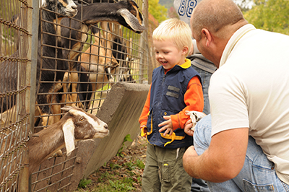
Individuals most at risk from zoonotic diseases
Children under 5
Seniors over 65
Pregnant women
People w/ chronic medical conditions
Urban/ suburban people
not immune to normal
germs found on farms
Photo credit: Center of Disease Control and Prevention

Slide 24
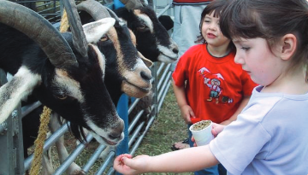
Farm Animal Safety Considerations
Animals in contact w/ visitors should be:
- clean, well tempered,
vaccinated (if applicable), &
monitored daily for health
issues.
Use a “feeding chute” to reduce animal/ visitor contact
Be sure animals are properly contained & secured
Kennel all farm pets
Photo credit: CDC’s Healthy Pets, Healthy People

Slide 25
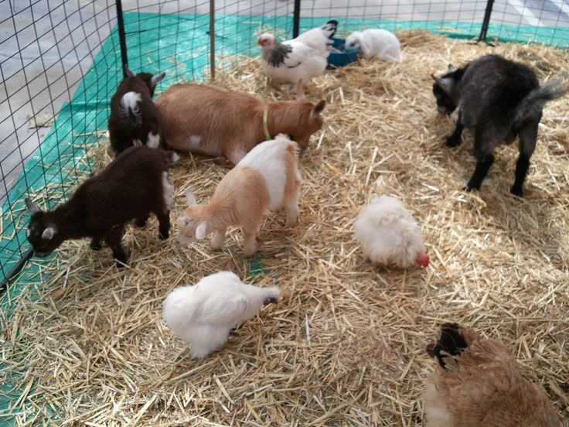
Farm Animal Safety Considerations
No reptiles or wild animal pets
Remove & dispose of manure in a timely manner
Replace animal bedding daily.
Clean & sanitize fencing daily
- clean & remove fecal matter
from surfaces assessable to
visitors in a timely manner.
Photo credit: Pinterest

Slide 26
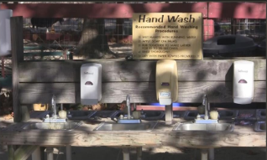
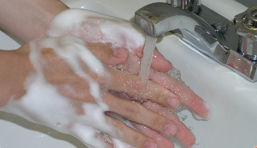
Farm Animal Safety Considerations
Inform visitors both
visually & verbally:
- about animal behavior
- to wash hands after
touching animals
- food & drink are prohibited
in animal areas
- to closely supervise children
interactions w/ animals
Route visitors to hand wash stations immediately after animal area
Photo credit; Samantha Rich, Bill Bamka

Slide 27
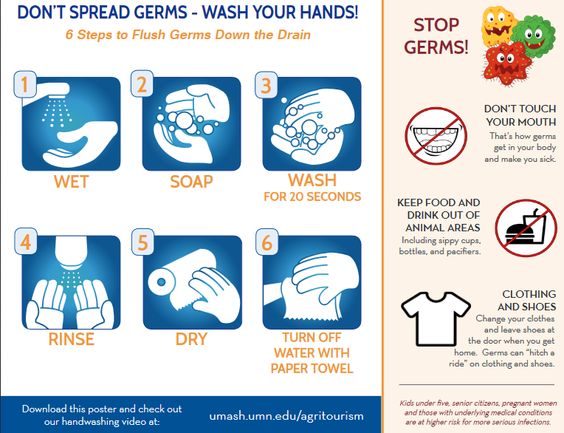
Farm Animal Safety Considerations
Handwashing- #1 way to prevent illness
Alcohol based hand gels:
- may be used in addition to
handwashing or until soap &
water is available
- doesn’t work if hands are
visibly dirty
- good against bacteria
- ineffective against
crypotsoridium (parasite)
Handwash video: umash.umn.edu/agritourism

Slide 28
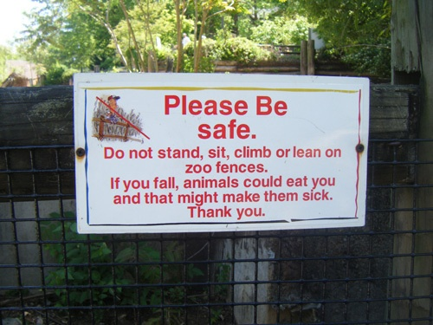
Fences & Barriers
Fences between all animals & visitors
Proper latches & locks for all gates
No barbed-wire, smooth electrical or woven wire fencing
Fence all off-limit areas
- from ground to 4 ft. ht.
Ropes, signs,& markers as guides

Slide 29
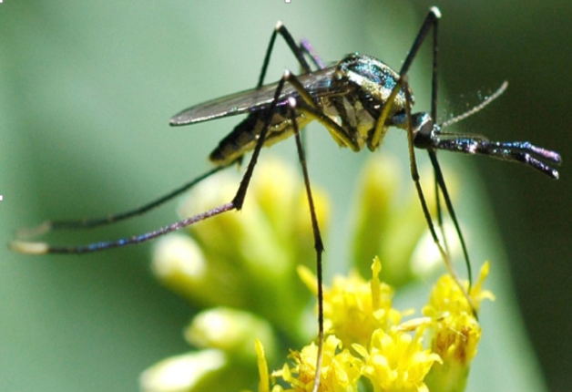
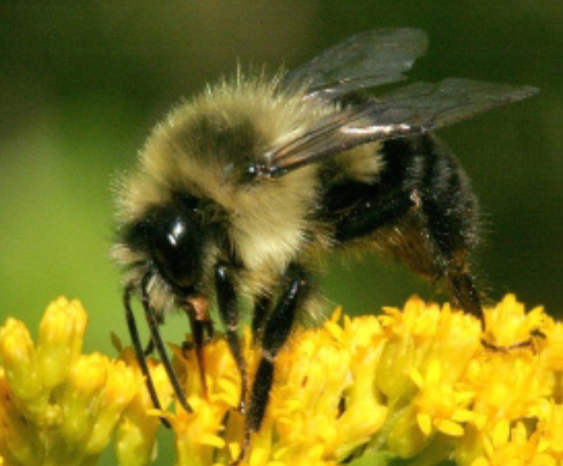
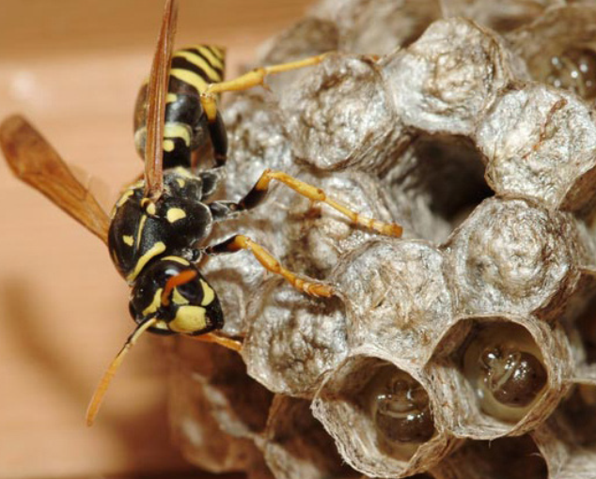
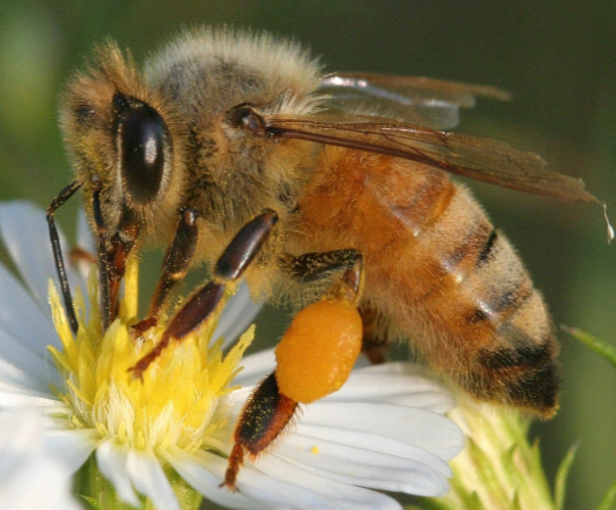
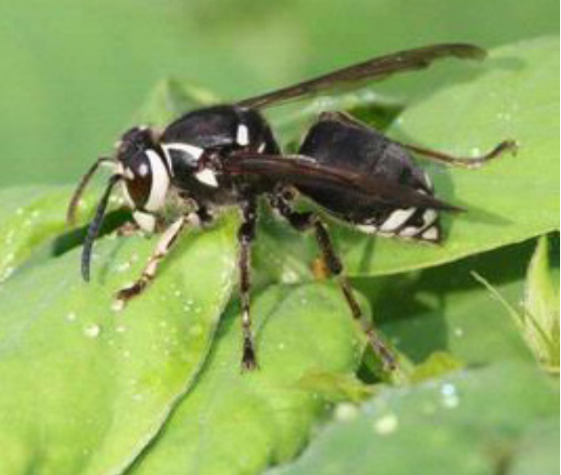
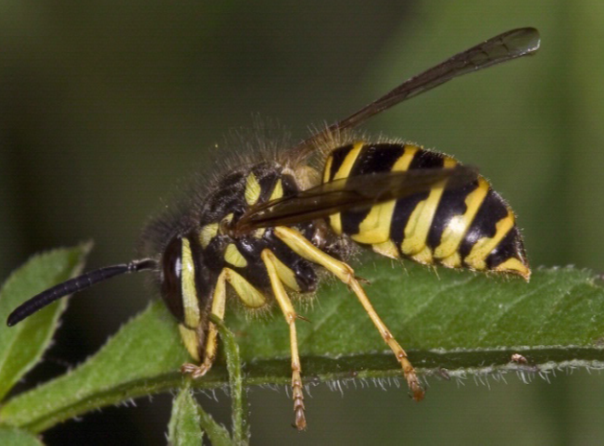
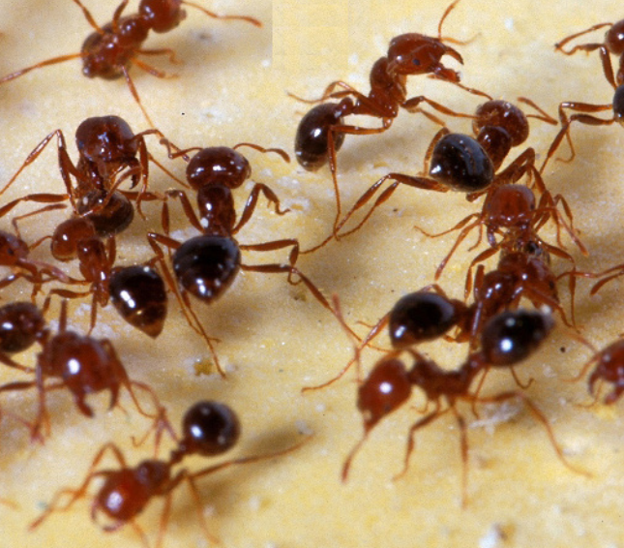
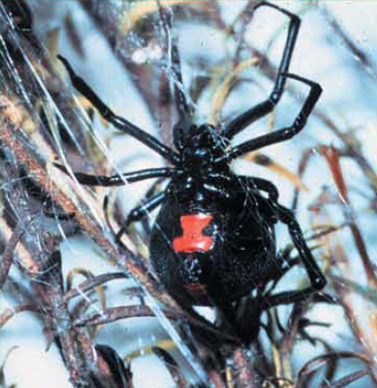
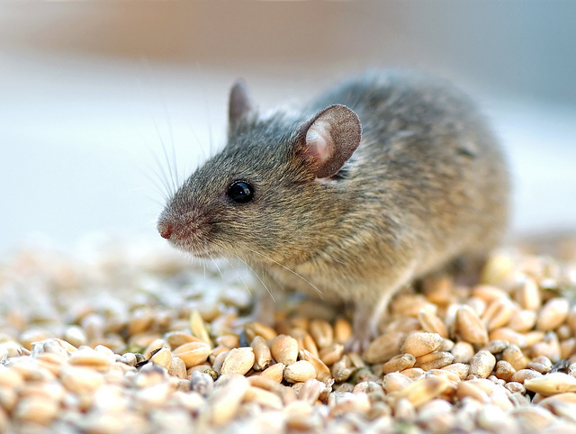
Venomous & Other Pests

Slide 30
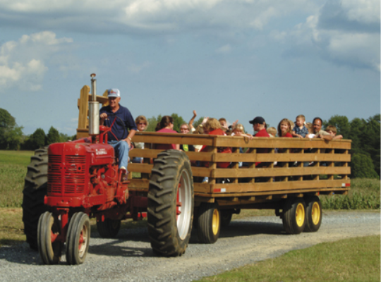
Wagon Ride Safety Considerations
Hay & wagon rides allow farmers to transport visitors while they enjoy the scenery
Potential liability exist while transporting guest
Inadequate supervision or training, poor site & crowd control or improper vehicle operation contribute to many accidents
Photo credit: Rural Mutual Insurance

Slide 31
Wagon Ride Safety Considerations
Route Inspection & Maintenance
Determine your travel route & inspect for potential hazards.
I.D. & address any hazards/ risks.
- Examples: overhead limbs & branches, overhead wires,
sharp turns, uneven ground, poorly drained soils
Avoid traveling on &/or crossing public roads.
Can emergency vehicle access the route if needed?
Make a daily pre-ride inspection for hazards.

Slide 32
Wagon Ride Safety Considerations
Tractor & Equipment Inspection
Only use a tractor with ROPS
Use tractors w/ power, weight, traction & braking abilities to control the load.
Inspect tractor & wagon before & after each ride.
Preform a complete service of tractor each day to ensure efficient operation
Use safety chains & never use more than one wagon per tractor
Inspect wagon for loose boards & railings, sharp edges, loose nails, screws & other hazards

Slide 33
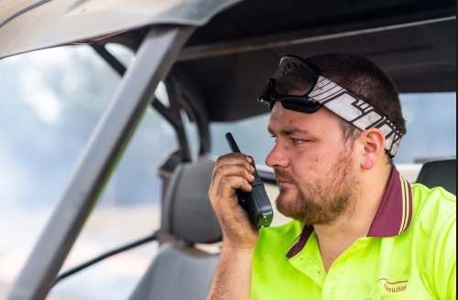
Wagon Ride Safety Considerations
Training & communication
Train all employees dealing w/ hay or wagon rides
All wagon rides should have supervisor or tour guide.
Have communication (cell
phone/ 2-way radio) to
insure contact at all times
& incase of emergency
Photo credit: autostock photo

Slide 34
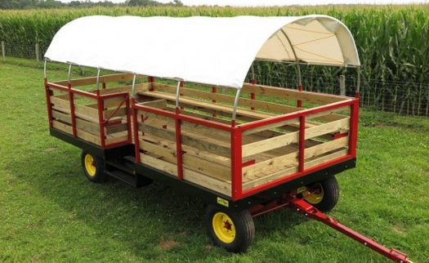
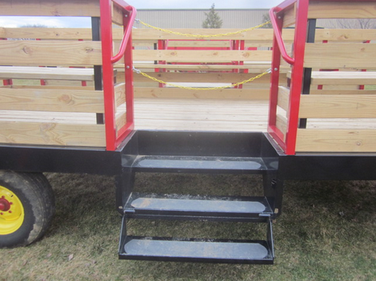
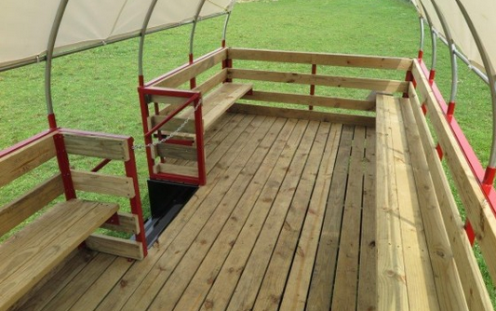
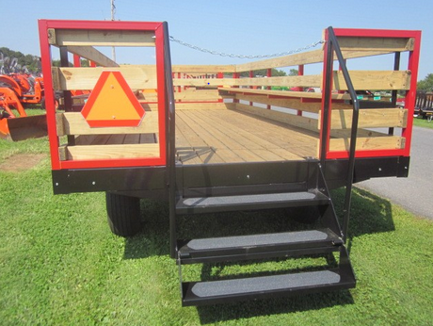
Examples of Wagon Safety Features
Stoltzful MFG
Stoltzful MFG
Stoltzful MFG

Slide 35
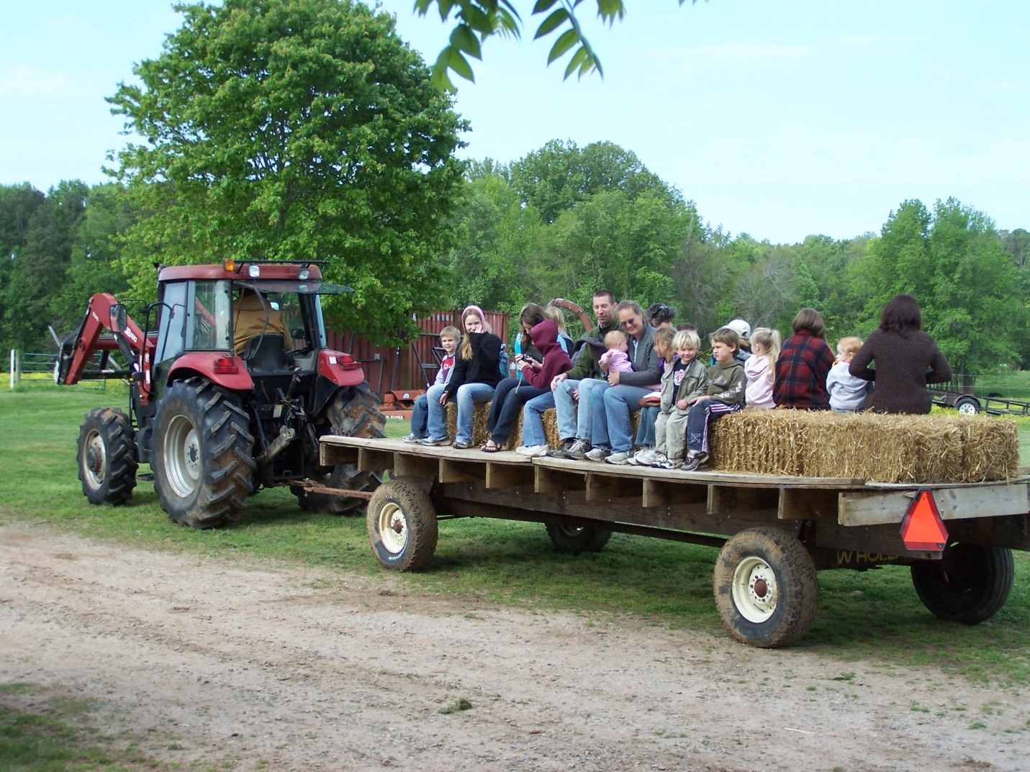
Can you spot the hazards?
No safety rails or guards
Hay for seating vs permeant benches
No steps for loading or unloading
No safety chains attaching tractor to wagon
Bale spear on loader
Photo credit: Phetrezler.worldpress.com

Slide 36
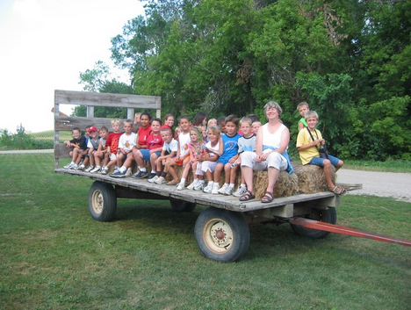
Can you spot the hazards?
Incorrect child to chaperone ratio
No safety rails or guards
No steps for loading/ unloading
Visitors wearing open top foot wear / sandals
Hay for seating vs permeant benches

Slide 37
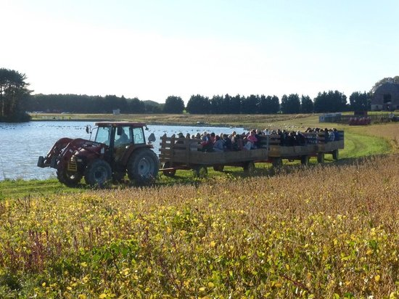
Can you spot the hazards?
More than one wagon being towed
Close proximity to water body

Slide 38
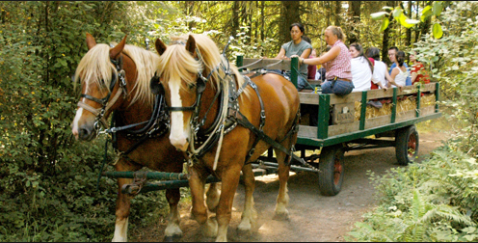
Can you spot the hazards?
Horse drawn wagon w/out braking system
Hay for seating vs permeant benches
Individual not properly seated
Photo credit: Cascades Camp & Conference Center

Slide 39
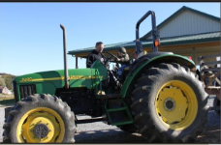
Farm Equip Safety Considerations
Properly train everyone who operates farm equip.
Shut down & remove keys when not in use.
Prevent visitors from accessing farm equipment.
Never allow visitors to operate farm equip, ride on tractors, ATV’s , etc.
If demonstrating equip. do
so at a safe distance away
from spectators.
Never operate equip that
can throw or eject objects
when visitors are present

Slide 40
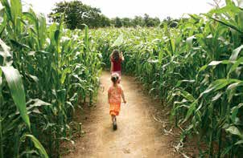
Corn Maze Safety Considerations
Control weeds in mazes. Weeds = rodents = snakes
Locate mazes at least 75 ft. from parking/ traffic
Post rules at entrance
Smooth, well maintained paths prevent trips & falls
Children under 12 accompanied by an adult
Observation tower w/ 2
supervisors to monitor
the activity.
Public address system to
communicate instructions
with visitors.

Slide 41
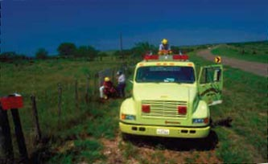
Corn Maze Safety Considerations
Review basic safety infor. w/ visitors prior to entering maze
Give flags to visitors entering the maze to be used to alert those monitoring the activity
Have a fire safety plan
- no smoking, lighters, matches or other open flame devices
- educate visitors on emergency exit plan
- have fire extinguishers available for
individuals monitoring the corn maze
- provide fire dept. with fire safety plan,
& size & location of maze
Photo credit: National Ag Safety Data Base

Slide 42
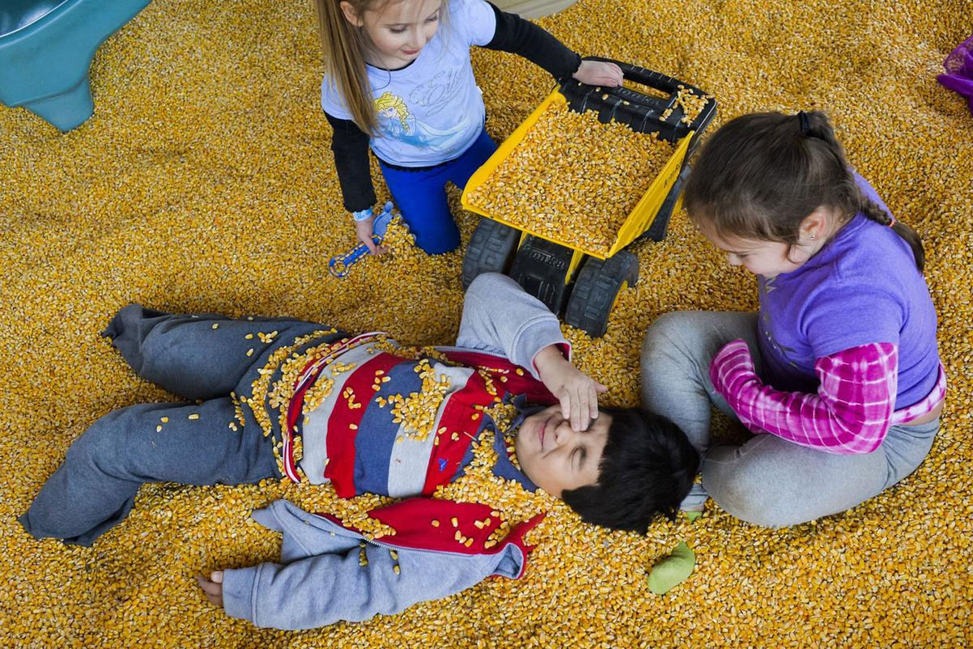
Play Area Safety Concerns
Location/ layout
- surroundings & hazards
Design & installation by professionals
Maintenance of wood, steel, & moving parts
Ground cover, rubber mulch, etc.
Rest area, protected from sun
Supervision
Post rules
Consider sand box instead of corn pit
Photo credit: Hearld-Dispach

Slide 43
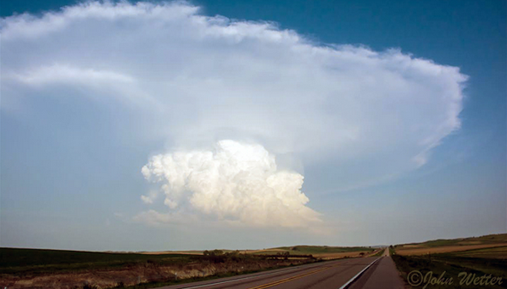
Hazardous Weather
Safety Considerations
Be aware of all hazardous weather warnings
Communicate weather conditions to employees
and visitors
Postpone activities if there is a high chance of hazardous weather
Make sure guests seek appropriate cover & provide them w/ adequate shelter
If shelter is not available have guest return to vehicles or busses.
Photo credit: National Weather Service

Slide 44
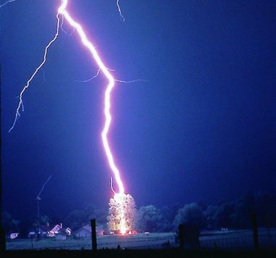
Hazardous Weather
Safety Considerations - Lighting
Take special precautions for lighting events, which can strike as far as 10 mi. ahead of storms
Only totally enclosed structures provide adequate protection against lighting strikes
Tents & canopies don’t “cut it!”
Photo Credit: National Weather Service

Slide 45
Hazardous Weather
Safety Considerations - Excessive Heat
Be aware of heat index - a combination of air temperature & relative humidity.
Know the signs of heat exhaustion & heat stroke.
- children & elderly are more susceptible to heat related illnesses
When heat index is high reschedule strenuous activities to early morning or evening.
Provide access to heat relief areas for visitors
- air condition room is best, but shaded areas will help.
- if no natural shaded areas, provide canopy for protection from
direct sunlight
Supply fresh drinking water or advise visitors to furnish their own. Make sure visitors stay hydrated

Slide 46

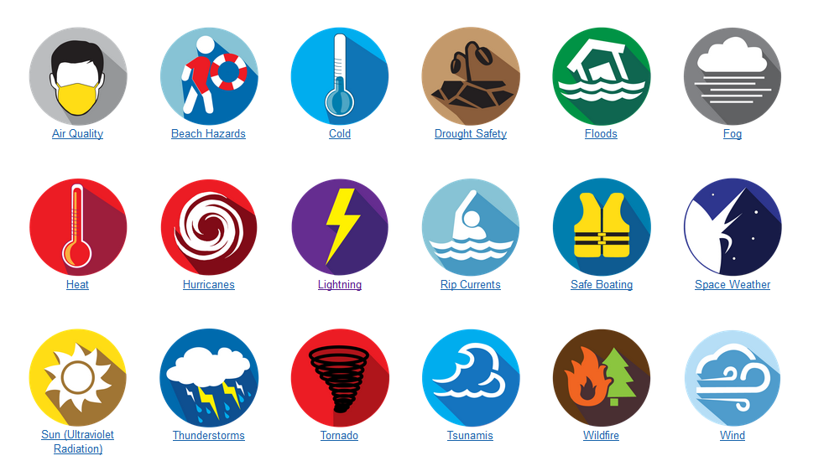
National Weather Service Safety Tips
https://www.weather.gov/safety/

Slide 47
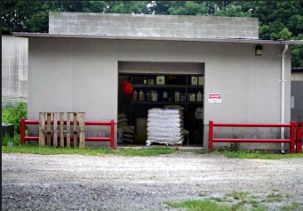
Pesticides & Chemical Storage
Always follow label directions when using pesticides
Keep records of all pesticide applications
Lock pesticides & fertilizers in an inaccessible cool, dry, well ventilated storage area.
Post signs designating area as off limits.
Photo credit: Bill Bamka , Rutgers NJAES Cooperative Extension Service

Slide 48
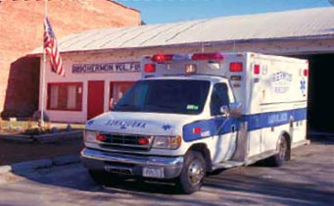
Emergency Planning & Response
Be Prepared Before an Emergency Occurs
Assemble an emergency response team
- insurance agent, attorney, EMS/Fire chief, law enforcement,etc.
Invite emergency responders to tour farm
Maintain current emergency contact list
Develop property map(s)
- google, FSA, Co. auditor, sketches
- address, GPS cords. road names/ #’s
- label attractions, buildings, parking,
potential hazards such as ponds, fuel
storage, pesticide storage, electrical
service poles, propane tanks, etc.

Slide 49
Emergence Response Plan
Be Prepared Before an Emergency Occurs
List locations of emergency equipment (i.e. first aid kits, personal protection equip.)
Maintain material safety data (MSDS) sheets
Estb. visitor capacity limits (buildings, attractions, rides)
Train employees on emergence response roles:
- CPR, American Red Cross First Aid training
Post “Incase of Emergency Signs” with appropriate information
Develop incident response report for documenting accidents/injuries

Slide 50
Emergence Response Plan
Key business/ emergency response contacts
Fire dept.
EMS
Local law enforcement
Local doctor/ hospital
Poison control center
Veterinarian
Utility companies
Chemical dealers
Equipment dealers
Insurance provider
Personal attorney
Extension contact (not me)
Other contacts specific to your operation

Slide 51
Emergence Response Plan
Emergency contact infor. in an accessible location
Farm name & location
- address
- GPS coordinates
- directions to nearest major intersection
- landmarks
Name & phone number & for:
- primary farm contact
- owner(s)/ manager(s)
- employees
Emergency contacts for farm owner(s), manager, & employees

Slide 52
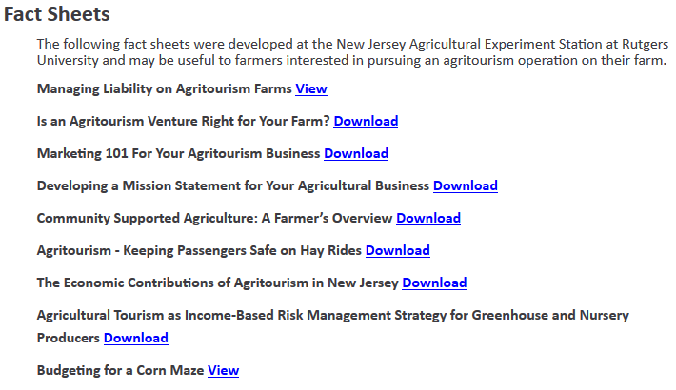

Resources

Slide 53
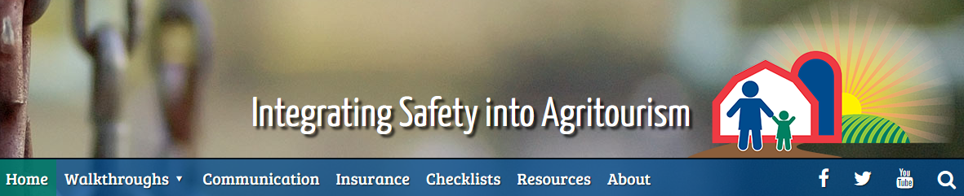

Resources
https://safeagritourism.org/
Photo credit: National Children’s Center for Rural Agricultural & Health Safety

Slide 54

Resources
UMASH-Upper Midwest Agricultural
Safety and Health Center
http://umash.umn.edu/agritourism/

Slide 55



Resources

Slide 56
Acknowledgements
Dr. Brian Schilling, Rutgers Cooperative Extension Service
Agrisafe Network
National Children’s Center for Rural Agricultural Healthy & Safety
Carrie Klumb, Minnesota Dept. of Health
Upper Midwest Agriculture Safety & Health Center
Ohio State University Extension Service
National Weather Service
Center for Disease Control
National Parks Service

Slide 57

Questions/ Comments
Photo credit: tcotton@morrowinsurance.com

